Slide 1
The Generalized Fractal Dimensions on the
Surface of a Tuburlent Tank
Mahesh M. Bandi
Center for Nonlinear Studies and Condensed Matter & Thermal Physics Division,
Los Alamos National Lab.
Walter Goldburg
Department of Physics & Astronomy, University of Pittsburgh.
Jason Larkin
Department Mechanical Engineering and Materials Science, University of Pittsburgh.

Slide 2
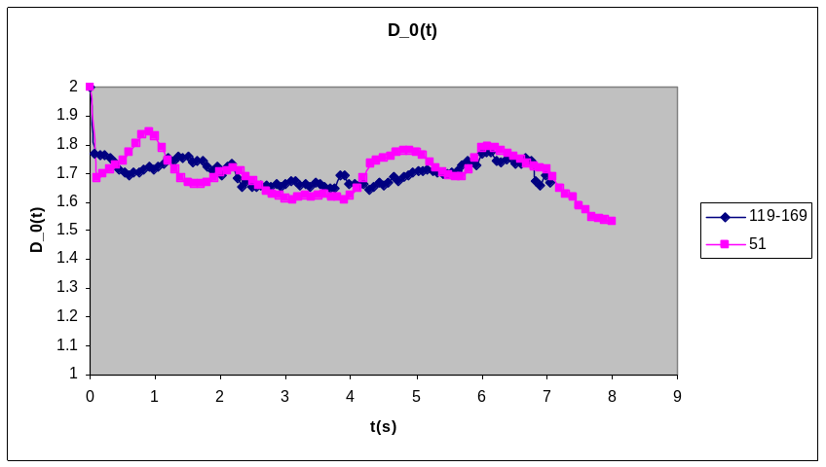
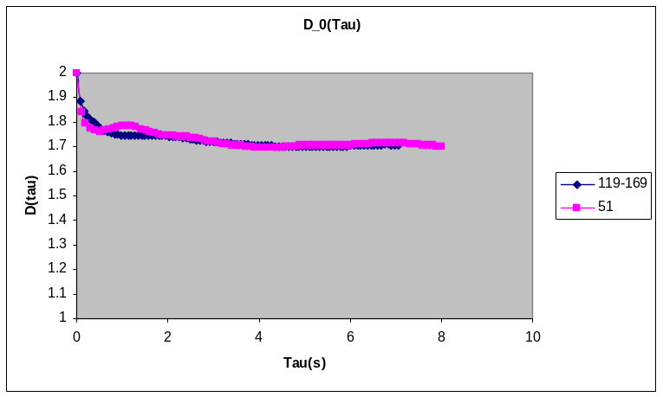
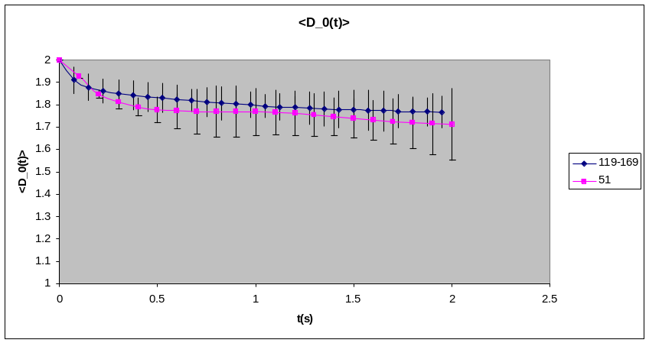
D_0
Notes: D_0 for ensemble average of Re=119-169 in close agreement with Re=51

Slide 3
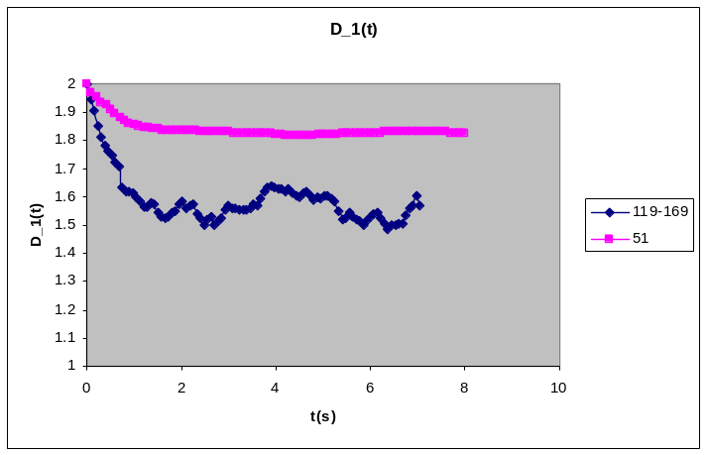
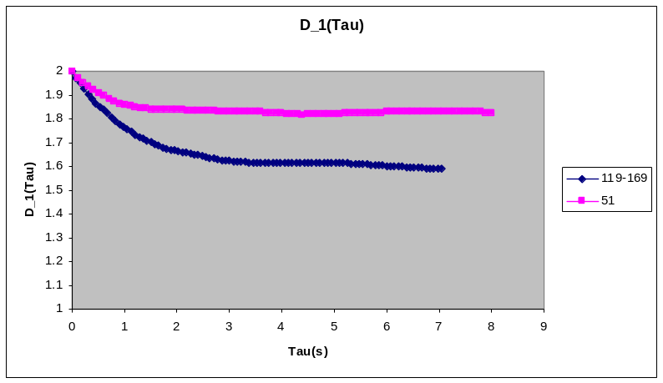

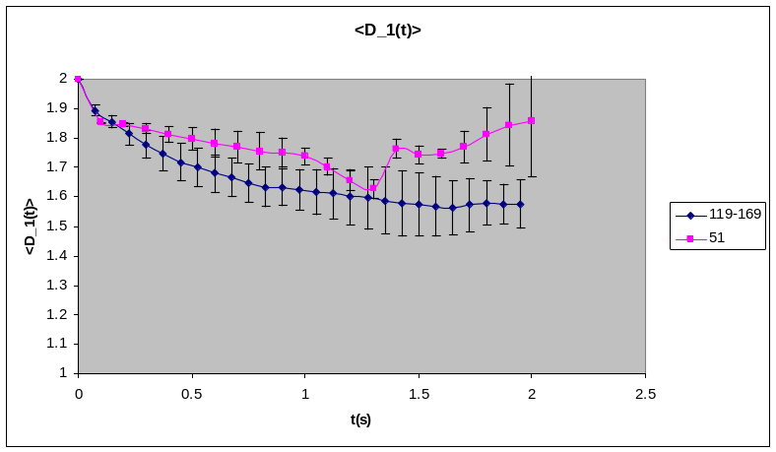
D_1
Notes: D_1 for ensemble average of Re=119-169 departs from Re=51 in both long time ensemble average and time-uncorrelation ensemble average

Slide 4
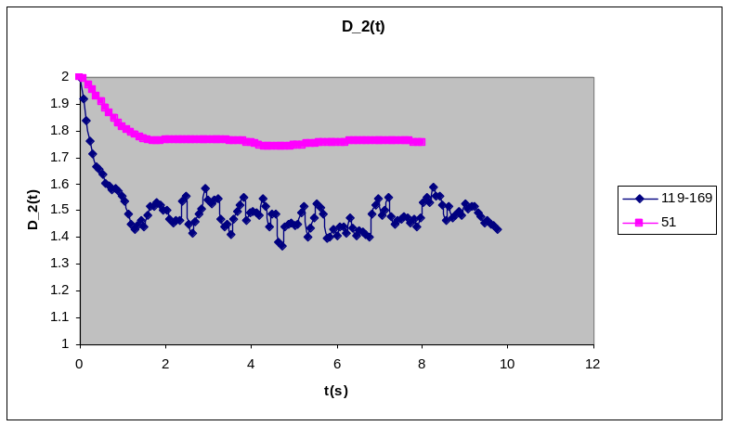
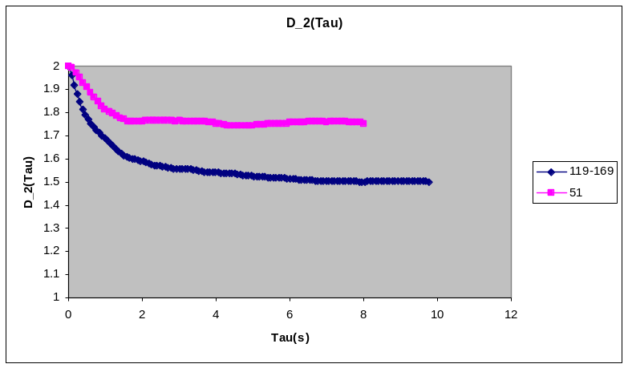
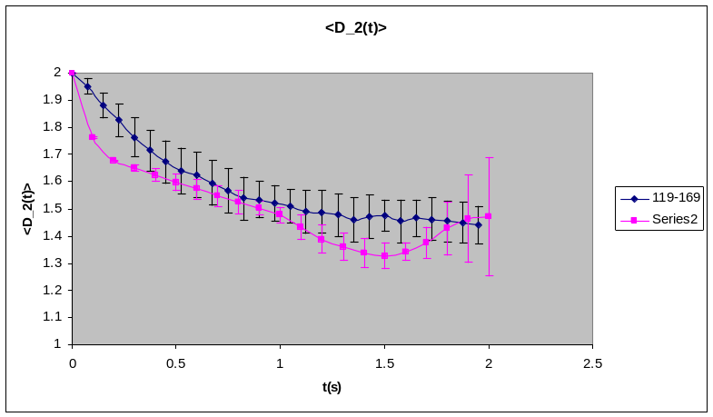
D_2
Notes: D_2 for ensemble average of Re=119-169 departs from Re=51 in both long time ensemble average and time-uncorrelation ensemble average

